Slide 1
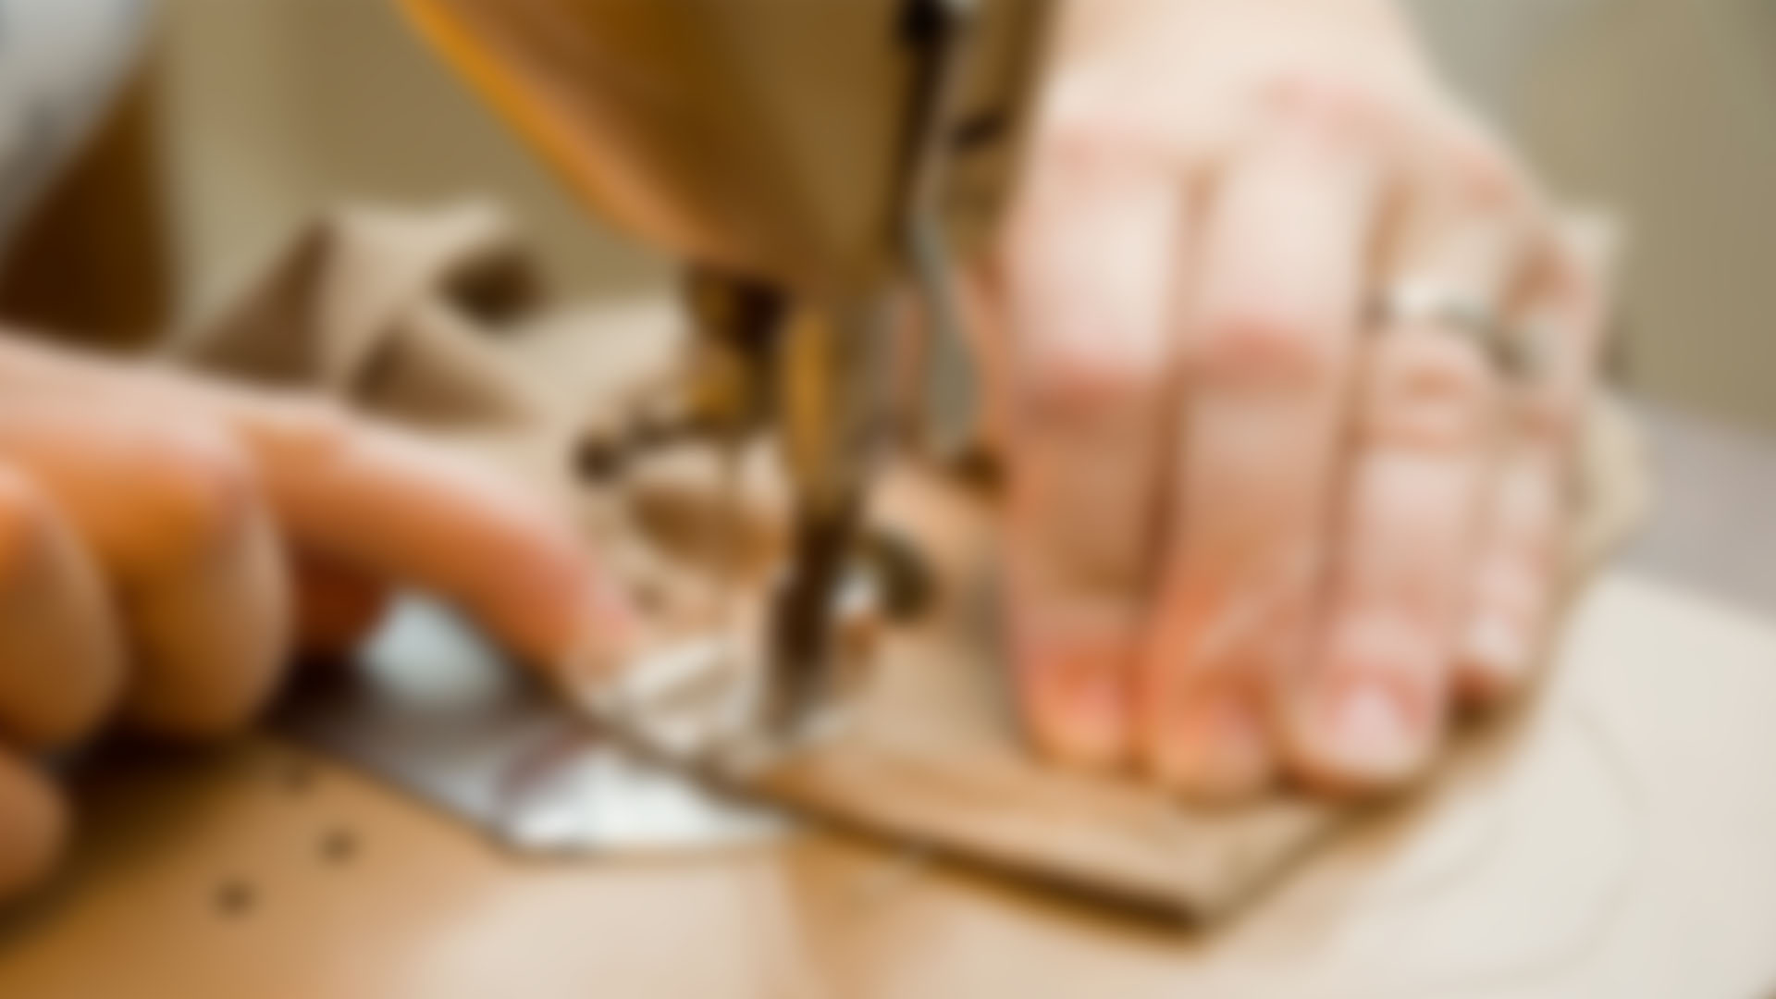



BELLA SUNSHINE DESIGNS
STYLE GUIDE
2018

Slide 2








BELLA SUNSHINE
DESIGNS
BRANDING
SLANTED MULTICOLOR LOGO
BLACK / #000000
TRANSPARENT PNG
GRAY / #999999
TRANSPARENT PNG
WHITE / #FFFFFF
TRANSPARENT PNG

Slide 3




BELLA SUNSHINE
DESIGNS
BRANDING
STRAIGHT MULTICOLOR LOGO
BLACK / #000000
TRANSPARENT PNG
GRAY / #999999
TRANSPARENT PNG
WHITE / #FFFFFF
TRANSPARENT PNG

Slide 4




BELLA SUNSHINE
DESIGNS
BRANDING
SLANTED MULTICOLOR UNFRAMED LOGO
BLACK / #000000
TRANSPARENT PNG
GRAY / #999999
TRANSPARENT PNG
WHITE / #FFFFFF
TRANSPARENT PNG

Slide 5




BELLA SUNSHINE
DESIGNS
BRANDING
STRAIGHT MULTICOLOR UNFRAMED LOGO
BLACK / #000000
TRANSPARENT PNG
GRAY / #999999
TRANSPARENT PNG
WHITE / #FFFFFF
TRANSPARENT PNG

Slide 6


BELLA SUNSHINE
DESIGNS
COLOR
PRIMARY SET
WEST SIDE
#FF8B0F
RASPBERRY PINK
#E84F90
TIFFANY BLUE
#00BBBB
MIKADO YELLOW
#FDCA10

Slide 7

BELLA SUNSHINE
DESIGNS
COLOR
SECONDARY SET
CAROUSEL PINK
#F9DFEB
HAWKES BLUE
#DAEAFF
MADANG
#B6EBA7
BISQUE
#FEE6C3

Slide 8
BELLA SUNSHINE
DESIGNS
COLOR
TERTIARY SET
SHERPA BLUE
#075151
JORDY BLUE
#83B9FD
FIERY ORANGE
#B35810
BLUE ZODIAC
#0D214B

Slide 9



BELLA SUNSHINE
DESIGNS
FONTS
FUTURA MEDIUM
FUTURA BOLD
ROBOTO REGULAR
ROBOTO BOLD
Al Fresco
QUICKSAND DASH
VTKS EMBROIDERY

Slide 10


BELLA SUNSHINE
DESIGNS
LAYOUT
H1 HEADER STYLE – 22 POINT FUTURA BOLD
H2 SUB HEADER STYLE – 20 POINT FUTURA
H3 SECTION HEADER STYLE – 16 POINT ROBOTO BOLD
Standard copy – 12 Point Roboto Regular

Slide 11


BELLA SUNSHINE DESIGNS
THANK YOU
STYLE GUIDE
2018

